Slide 1
Pop-up Paper Circuits
Angela Sheehan, Amanda Clark, Pamela Cortez

Slide 2
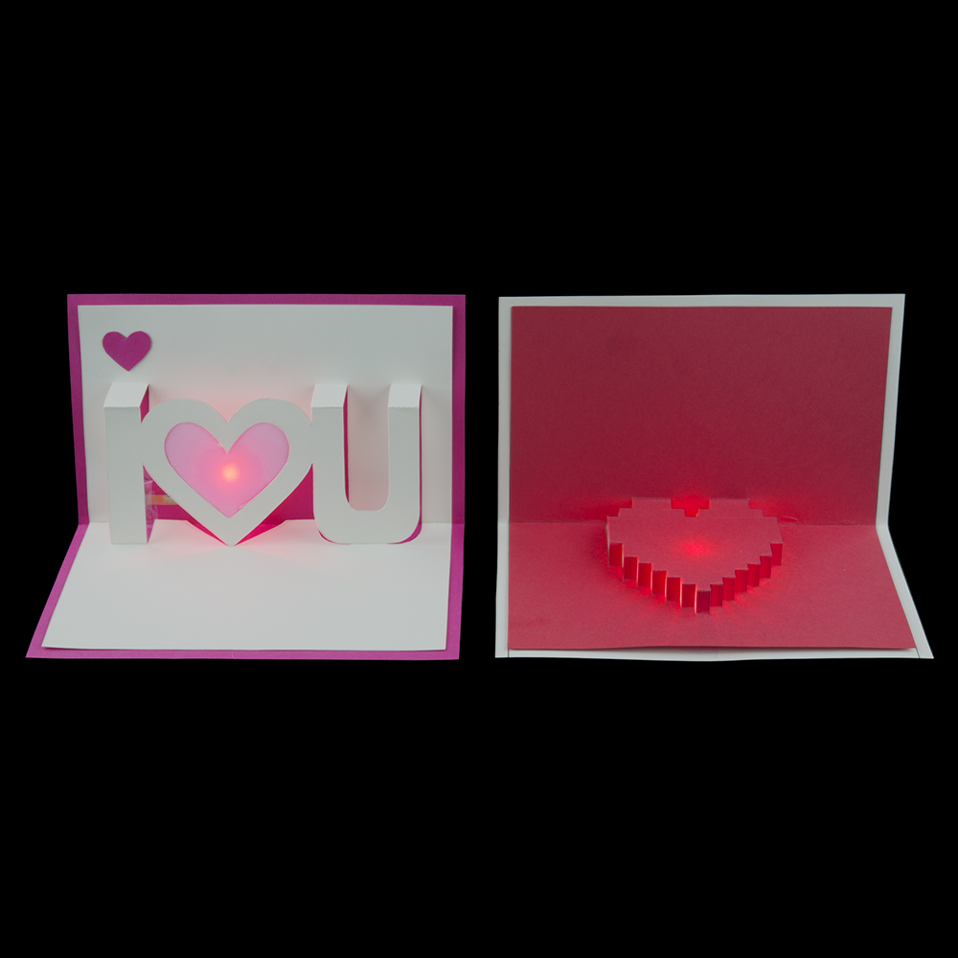
What we’re making today:
Light Up Valentine’s Day Pop Up Cards

Slide 3
Folding Tips:
Cut some vellum a little bigger than the hole in the heart and paste/tape in before you start folding.
Push the bottom of the U or I letters down first and work your way up to the smaller folds.

Slide 4
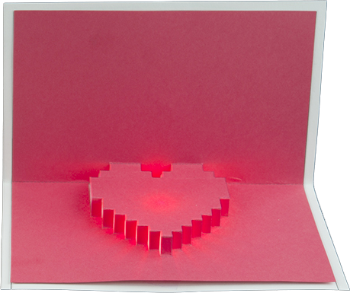
Folding Tips:
This template is tricky and takes some patience to fold. Hang in there!
Hold the template upside down and start with the point of the heart. Use gravity to help you pull all the little folds up one by one.

Slide 5
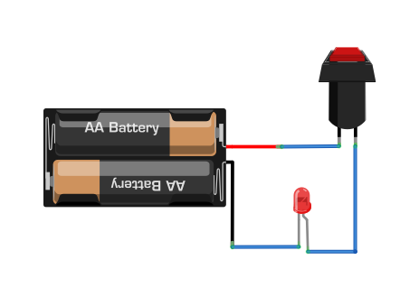
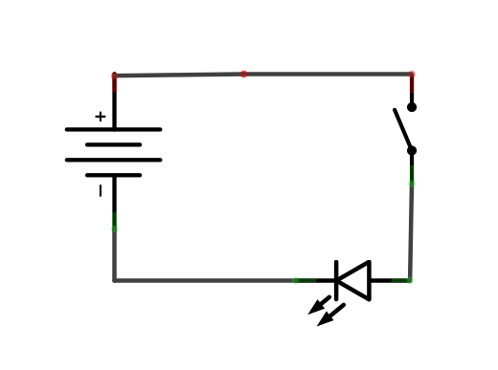
Basic Circuit
Circuit → Circular path that electricity flows through.

Slide 6
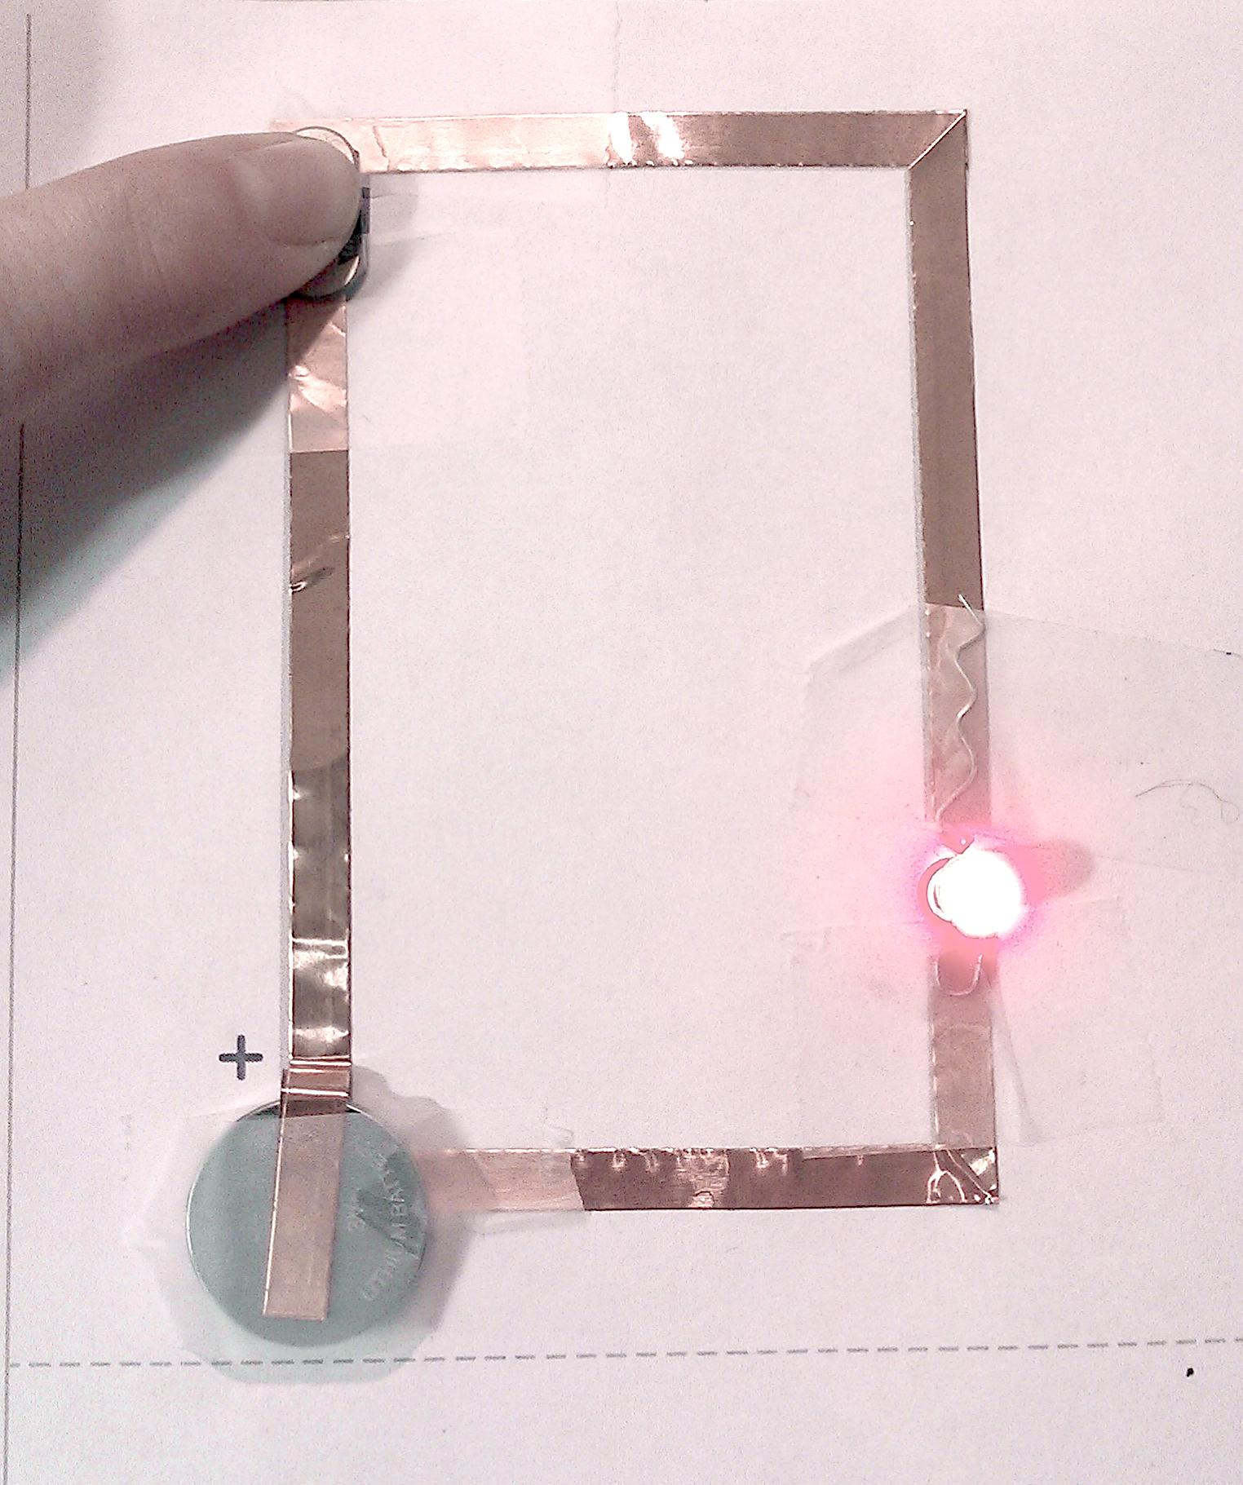
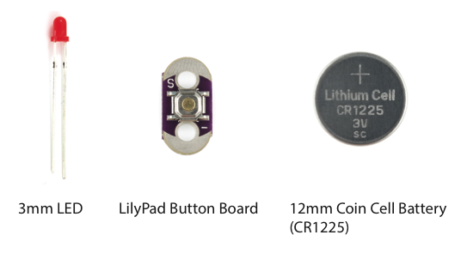
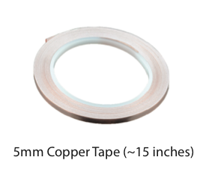
Completed
Paper
Circuit

Slide 7
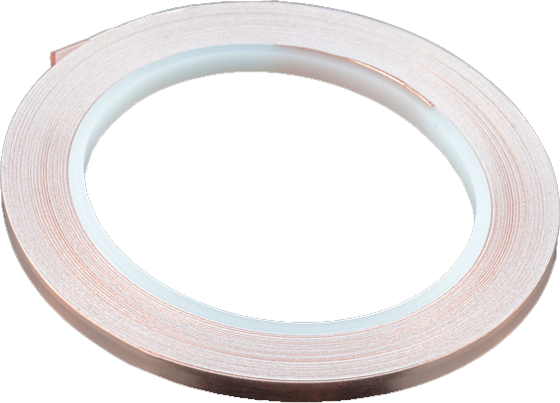
About Copper Tape
Pros:
Nice and conductive!
Peel & stick.
Can use conductive paint to attach components to it.
Can solder components to it.
Cons:
Need a continuous line, have to get creative about corners.
Adhesive is NOT conductive.
Can have sharp edges - be careful!

Slide 8
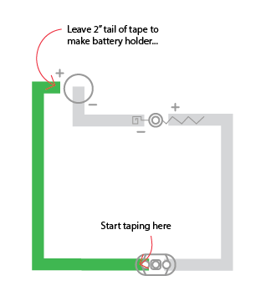
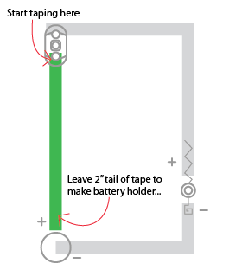
Let’s Get Started!
I U
Heart

Slide 9
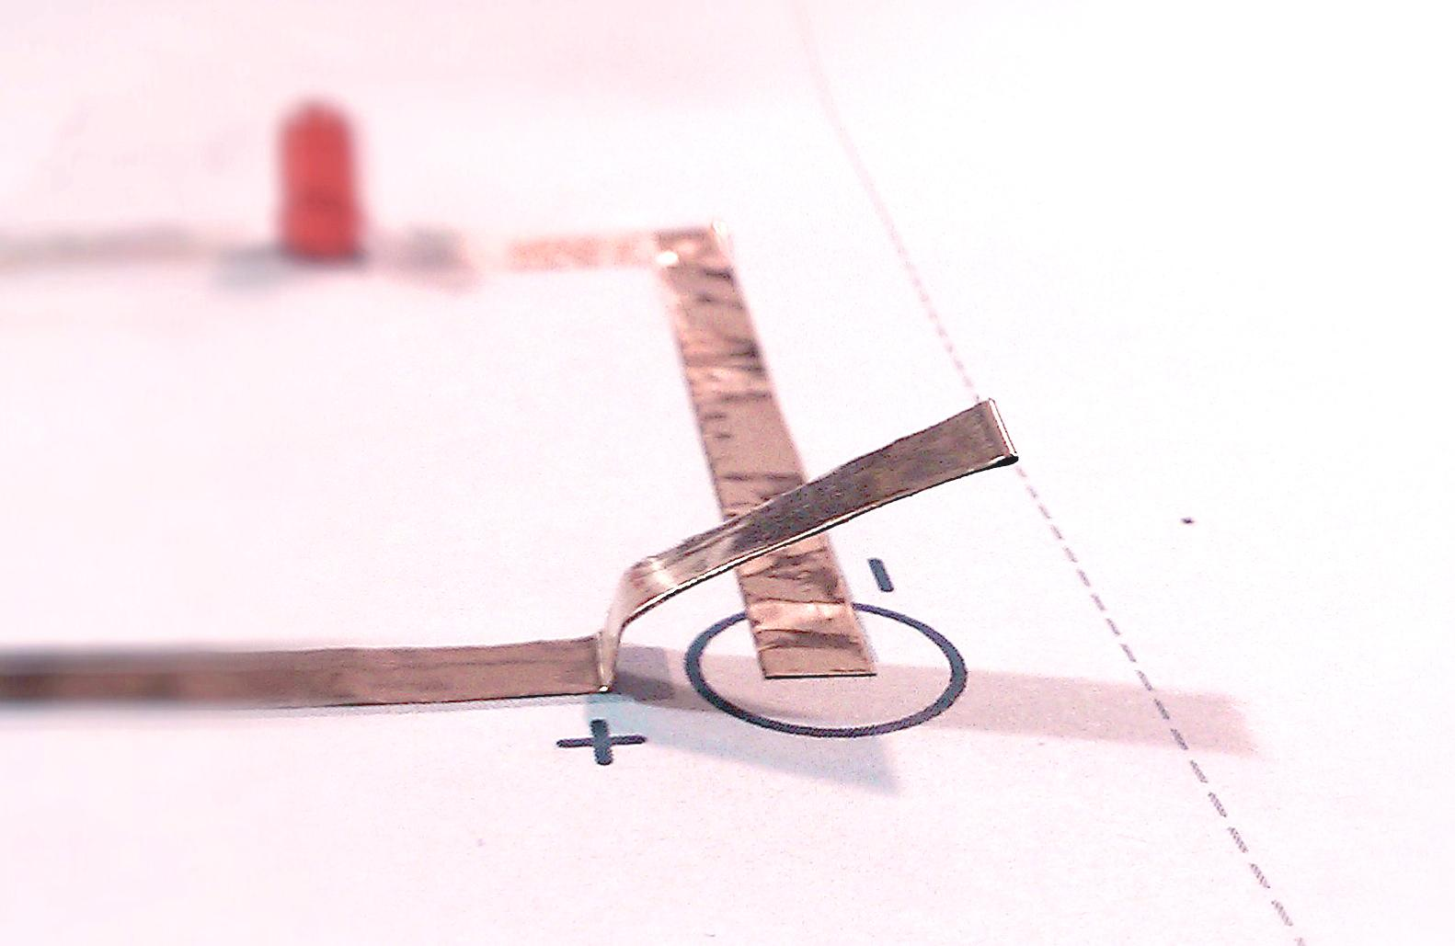
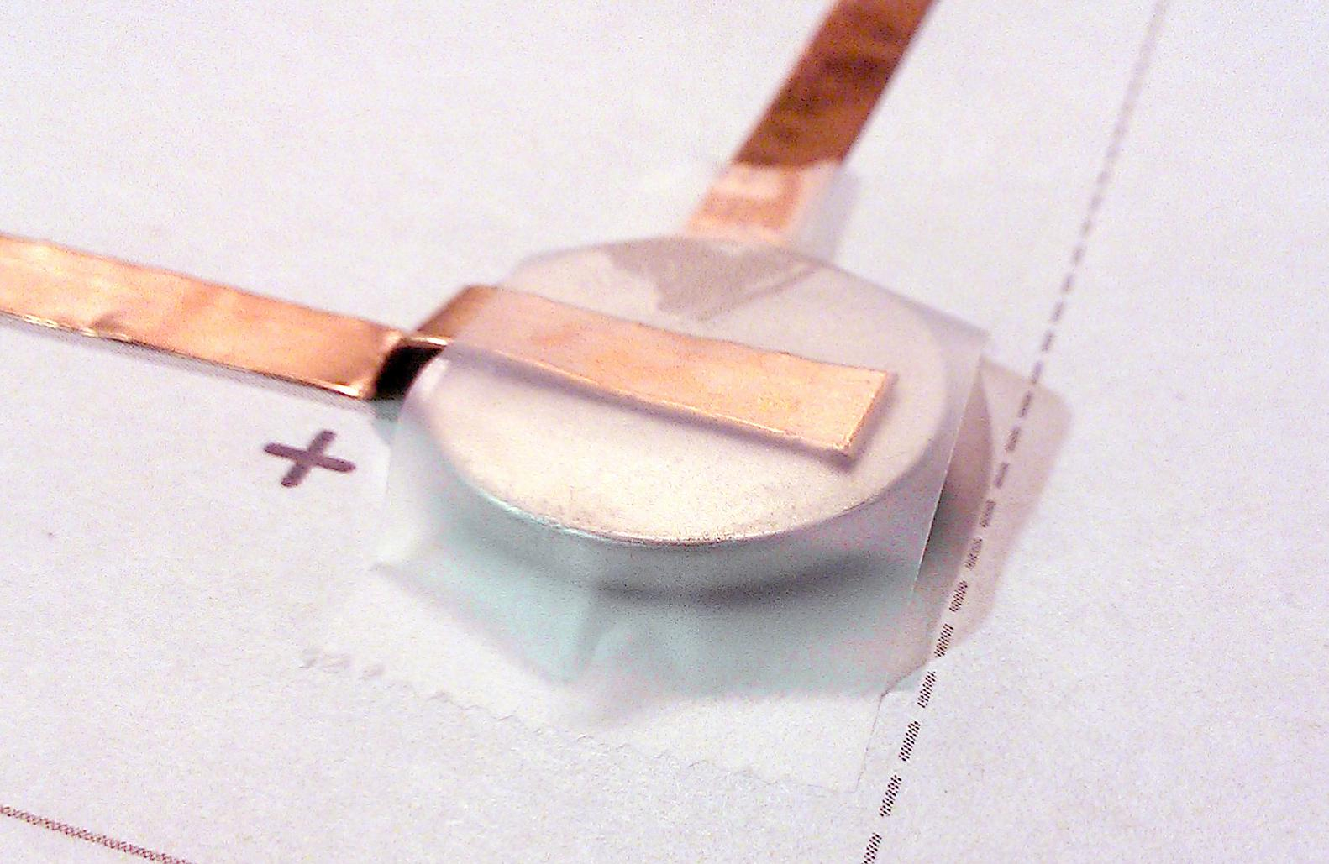
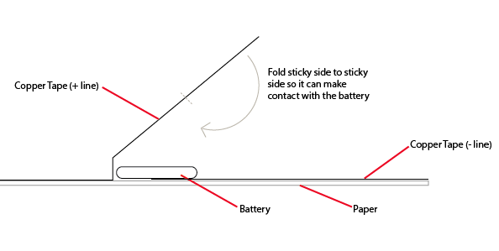
Making a Battery
Holder
The side with the labels/writing is the top of the battery.

Slide 10
Corners
FOLD FORWARD
FOLD
DONE!
It’s okay if your fold isn’t perfect - we just want to go around the corner without the tape breaking.

Slide 11
Joining Tape - in case of breaks/tears
Overlap Top-side to Top-side
FOLD BACK
BREAK
FOLD
1/2 AGAIN
JOINING PIECE
Joining by touching the TOP-SIDE to the TOP-SIDE of each section. Secure with Clear Tape.

Slide 12
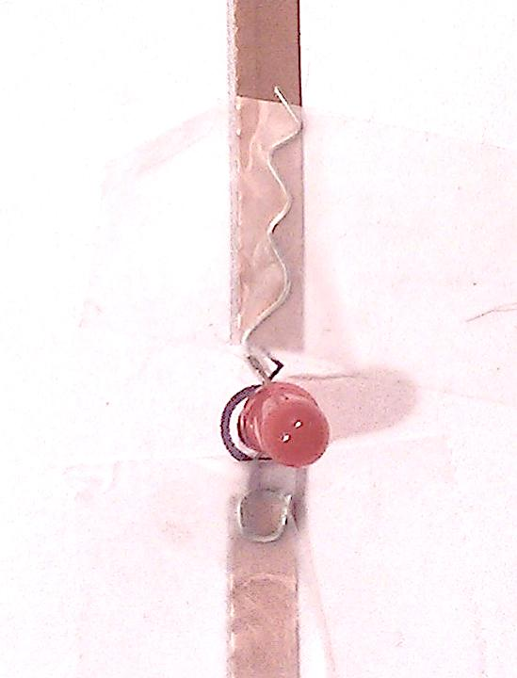
LEDs
Stick the LED to your copper tape with clear tape, make sure the + and - are aligned correctly.

Slide 13
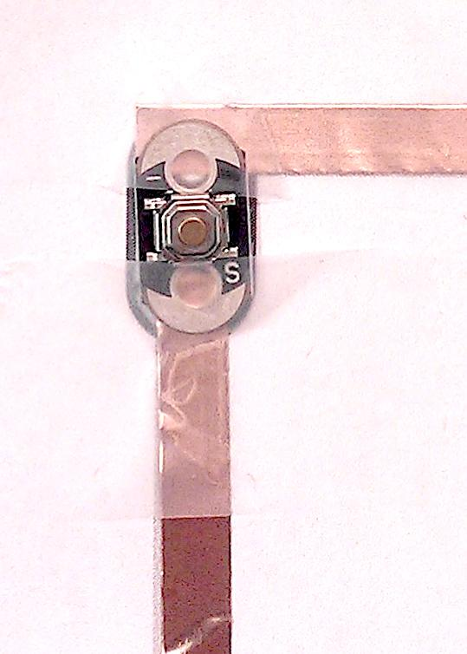
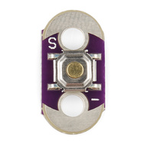
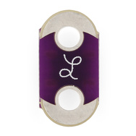
Add the Button
Try not to tape directly over the push button, keep to the ends.
Conductive Pads

Slide 14
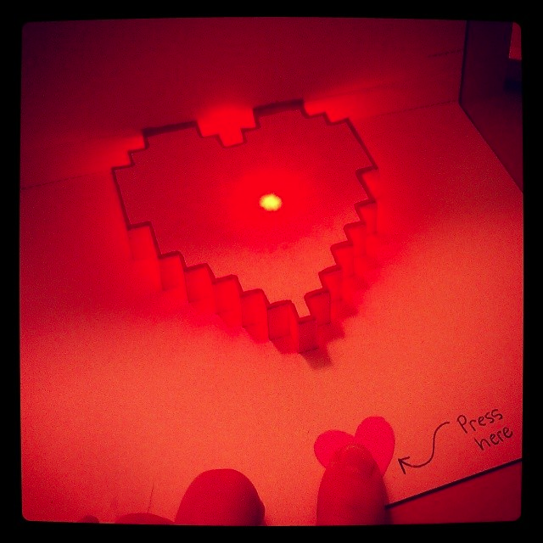
Add text or symbol showing where to press
If you are mailing your card - use Parcel Post so the LED won’t get crushed by sorting machines :)

Slide 15
www.sparkfun.com
6175 Longbow Drive
Boulder, Colorado 80301

