Slide 1
Sewing Circuits
Angela Sheehan, Amanda Clark
Notes:
One prebuilt of each circuit for each group, who has what experience?

Slide 2
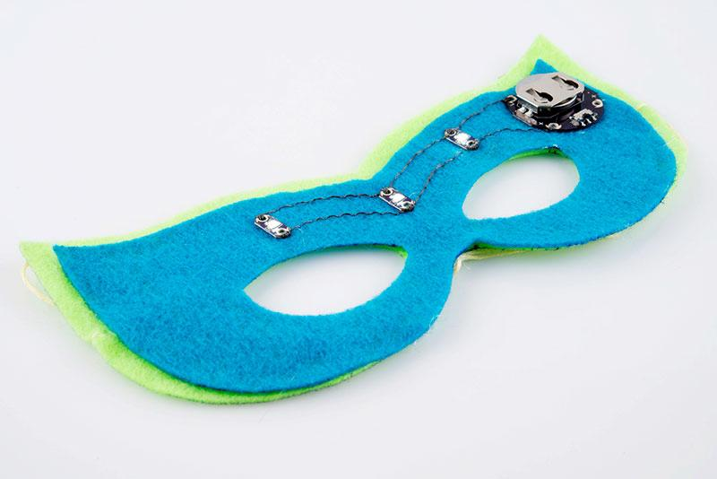
What we’re making today:
e-Textile Masks!

Slide 3
E-Textiles
*
Sewable Circuits
*
Soft Circuits
*
Wearable Electronics

Slide 4
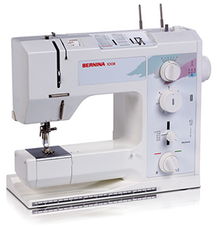
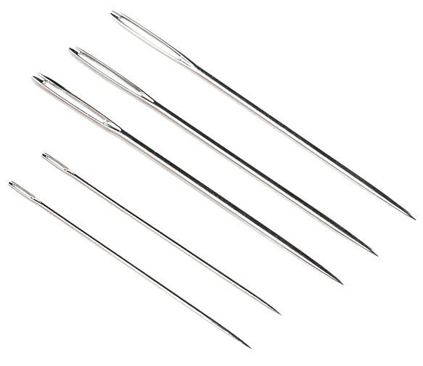
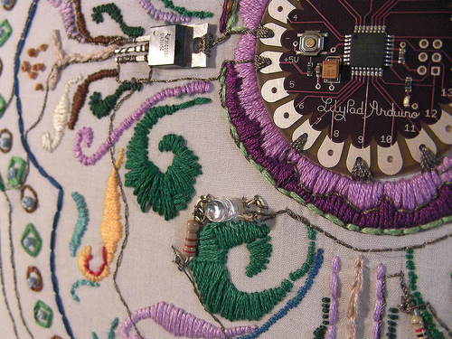
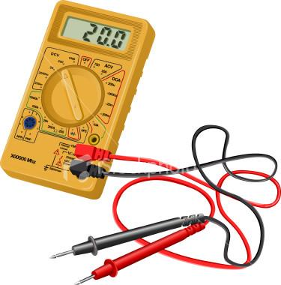
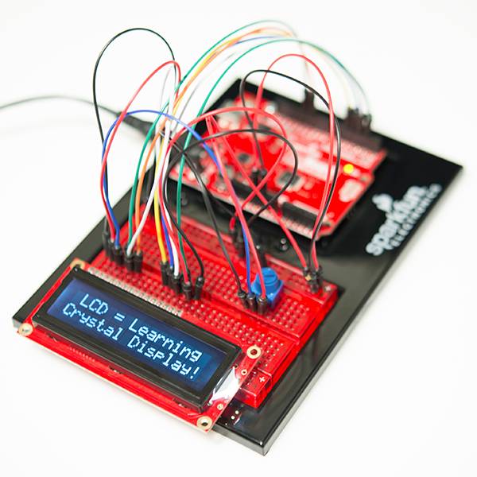
Fabric and Fiber Arts, Traditional Craft, Fashion Techniques
Becky Stern’s LilyPad Embroidery
Electronic Prototyping, Interaction Design, Computer Programming, Engineering

Slide 5
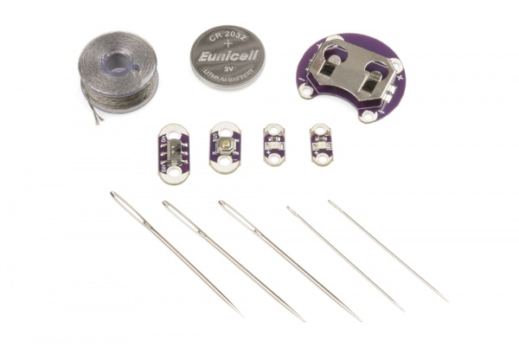
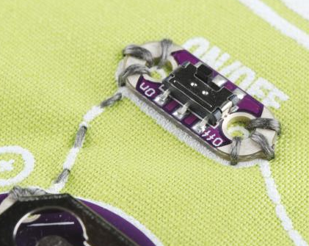
Why Use Sewable Electronics?
Washable
Easy to incorporate into overall design
Utilize sewing techniques vs soldering
Lightweight and small
LilyPad Arduino - programmable
A different way to approach electronics

Slide 6
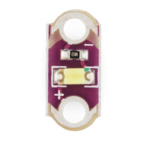
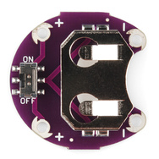
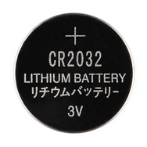
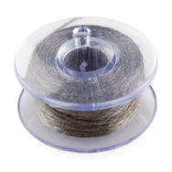
Materials
LilyPad Coin Cell Battery Holder - Switched
Coin Cell Battery
20mm (CR2032)
Conductive Thread
(Stainless Steel)
LilyPad LEDs

Slide 7
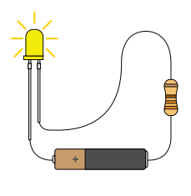
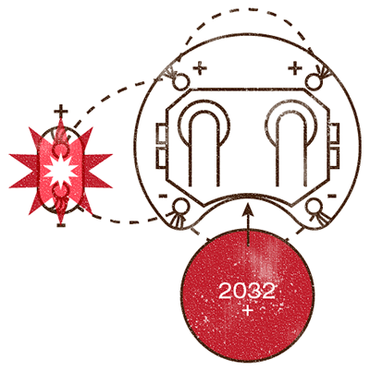
Basic Circuit
Traditional Electronics
Sewable Electronics

Slide 8
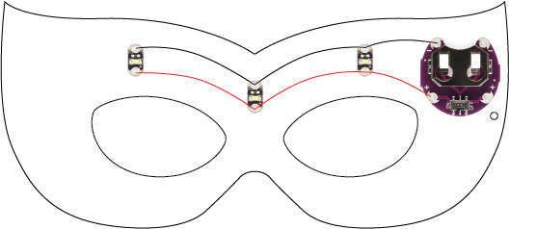
The Mask Circuit
Negative Connections
Battery Holder
LED Boards
Positive Connections

Slide 9
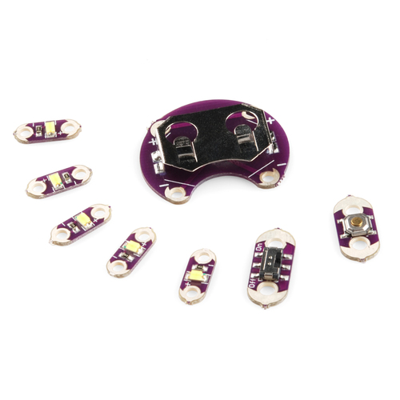
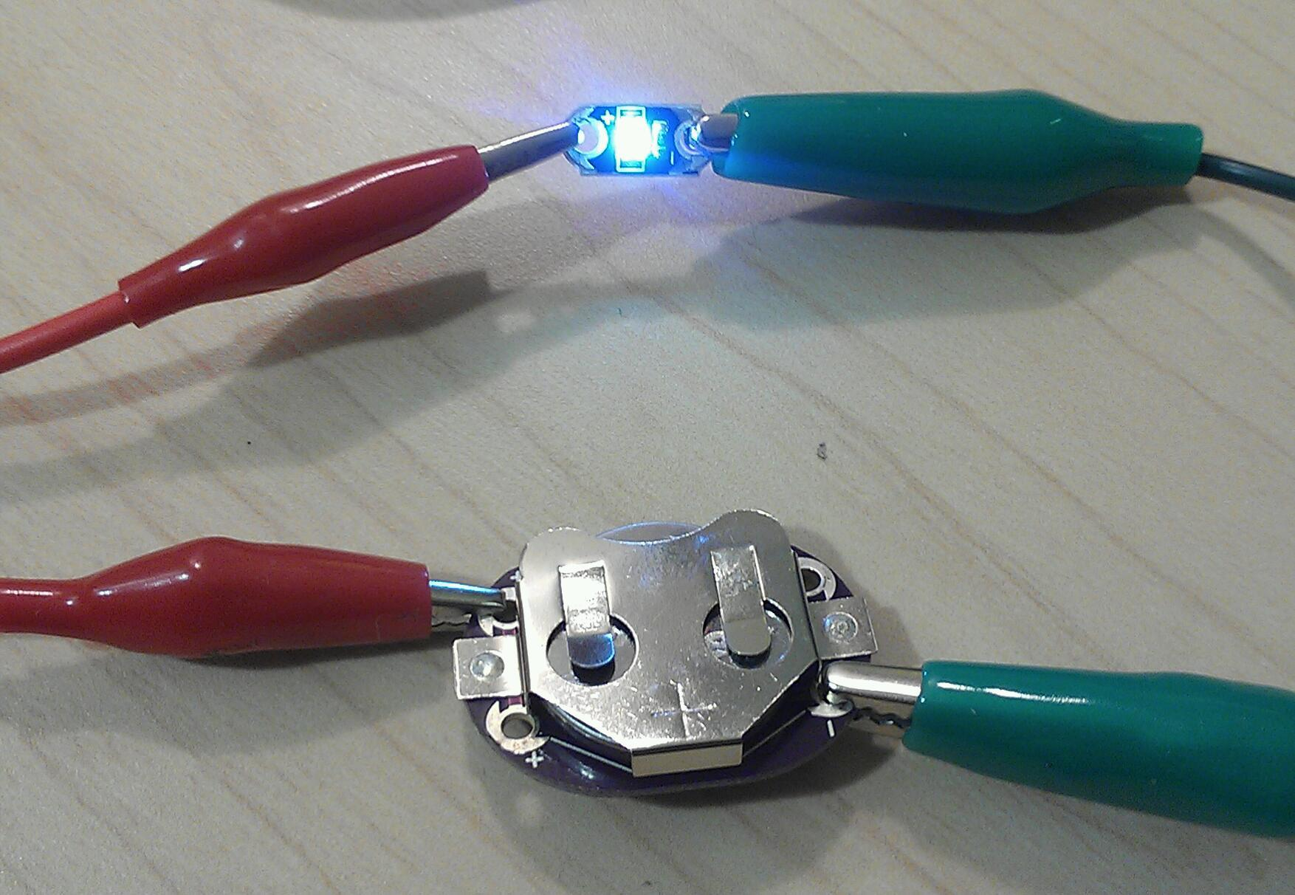
Planning a Project
What will it do?
Brainstorm, sketch, pseudocode (if using a microcontroller)
Plan your circuit
Map out placement of components and connections, sketch ideas.
Test it out
Test your hook ups and code before you sew! Alligator clips (or leaving the board snapped together) lets you test before sewing your project together.

Slide 10
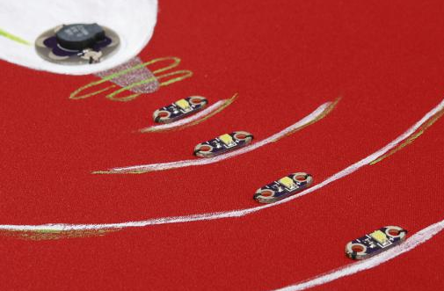
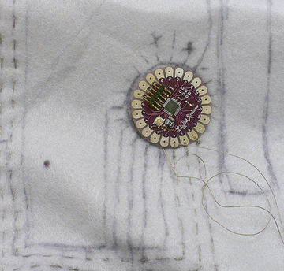
Design Circuit Traces Before Sewing
Place components where you want them on your project - drawing a rough sketch on a piece of paper for general placement helps a lot.
With a pencil or chalk - draw the connections between components, these will act as your sewing guide.

Slide 11
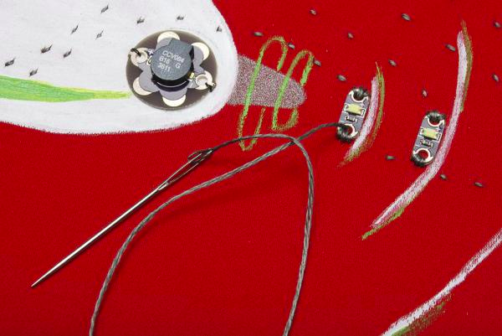
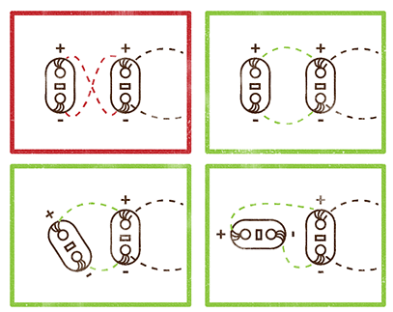
Sewing Components
Sew conductive thread along your planned traces and loop through the conductive pads at least 3 or 4 times for a good connection.
More info: Sewing with Conductive Thread Tutorial
https://learn.sparkfun.com/tutorials/sewing-with-conductive-thread

Slide 12
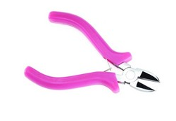
Useful Tools
Fray Check/Fabric Glue
Needle Threader
Embroidery Needles
Beeswax
Iron
Multimeter
Small Pliers
Diagonal Cutters
Soldering Iron/Solder

Slide 13
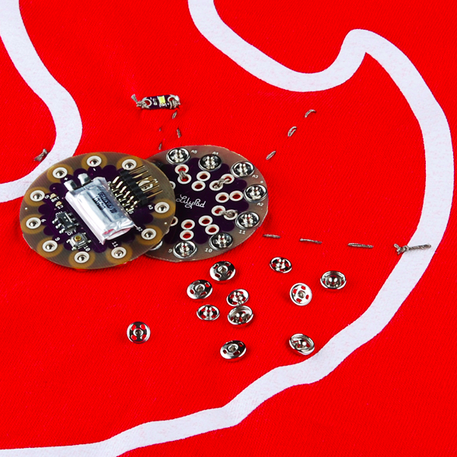
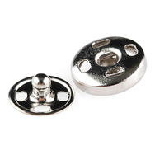
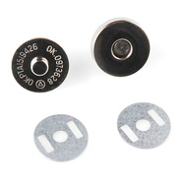
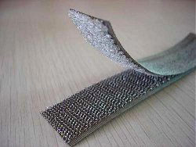
Connectors
You can use traditional craft findings to make detachable parts. Experiment with a multimeter and craft supplies to see what cool things you can use as connectors.
Sewable Snaps
Magnets
Conductive Velcro
Zippers
Buckles/Clasps
LilyPad Arduino
SimpleSnap
Image from LessEMF.com

Slide 14
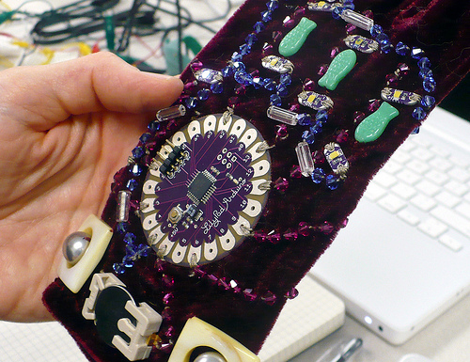
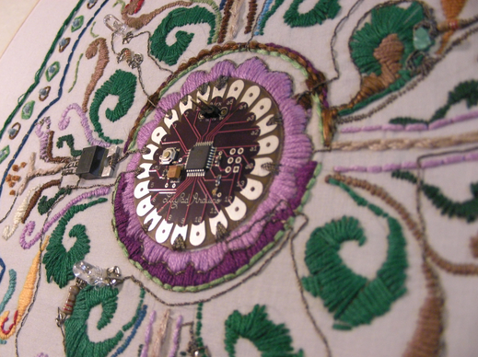
Beads used with conductive thread by Janet during a class at SparkFun https://www.sparkfun.com/news/533
LilyPad Arduino in an embroidery by Becky Stern http://sternlab.org/2008/04/lilypad-embroidery/

Slide 15
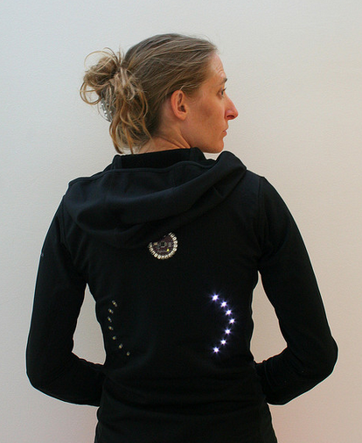
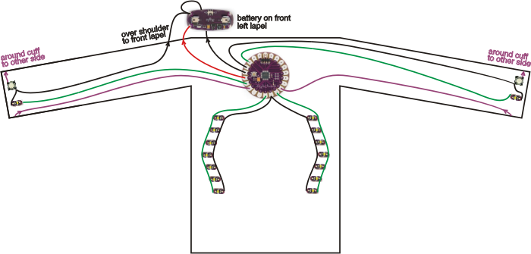
Turn Signal Bike Jacket by Leah Buechley | 2008
http://web.media.mit.edu/~leah/LilyPad/build/turn_signal_jacket.html
LEDs to show when biker is turning, like car turn signals.

Slide 16
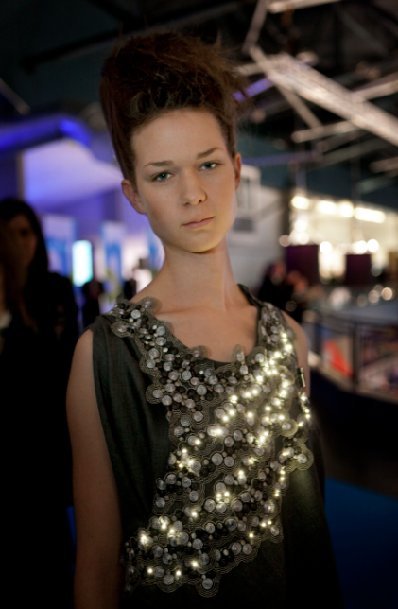
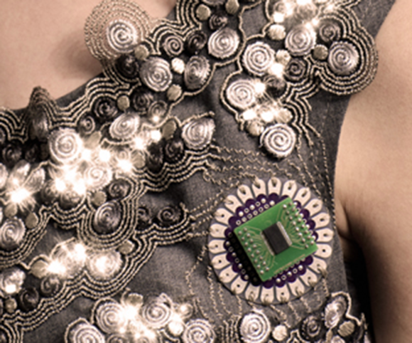
Climate Dress by Diffus Design | 2009
http://www.diffus.dk/climate-dress/
Senses CO2 in the air and displays as light patterns

Slide 17
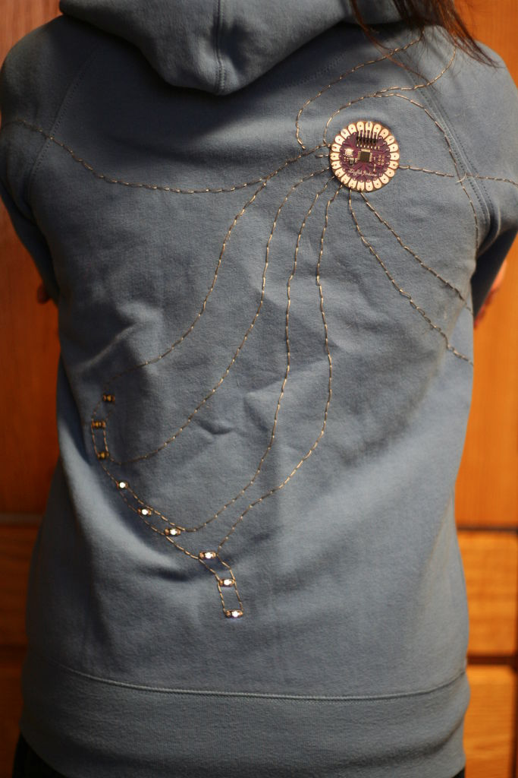
Soundie by Kanjun Qiu | 2009
http://www.instructables.com/id/musical-conductivity-detecting-light-up-hoodie/#intro
A touch-sensitive light-up hoodie that makes sounds

Slide 18
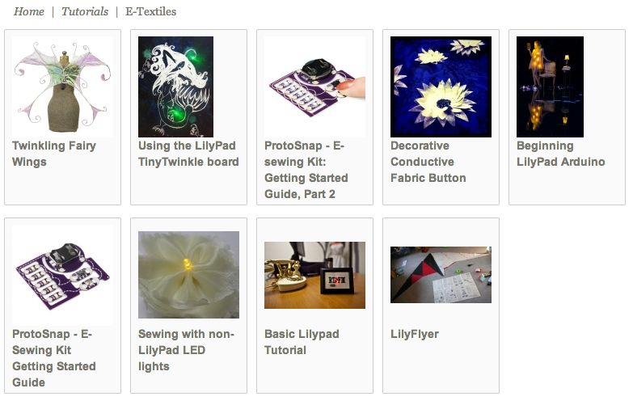
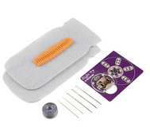
SparkFun E-Textile Tutorials
https://learn.sparkfun.com/tutorials/tags/e-textiles
Firefly Jar Kit
https://learn.sparkfun.com/tutorials/firefly-jar

Slide 19
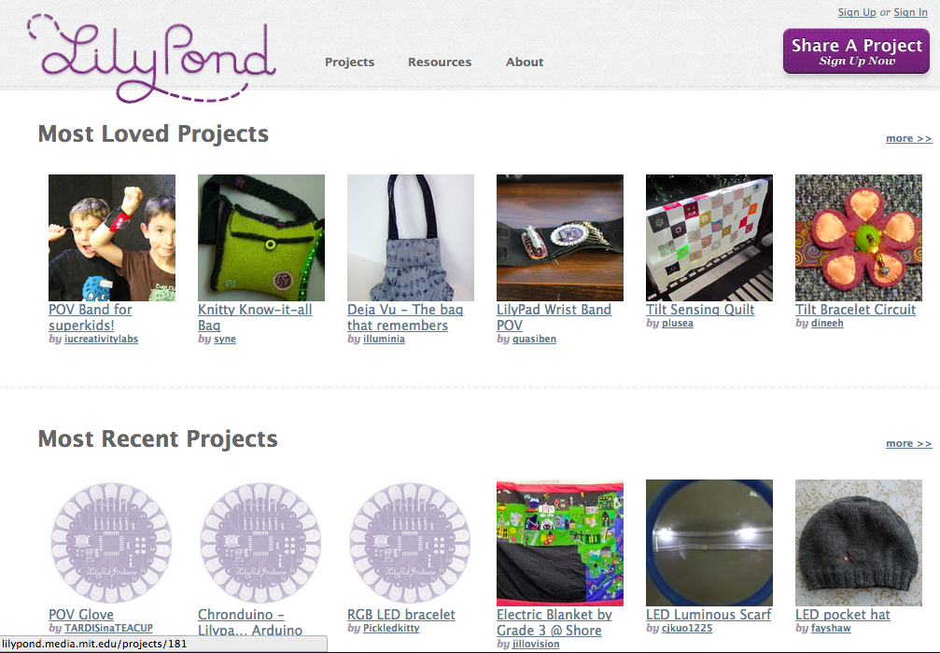
LilyPond project sharing site
http://lilypond.media.mit.edu/

Slide 20
Basic Sewing Resources
Additional Resources
http://hlt.media.mit.edu/
MIT Media Lab focusing on crafting with technology.
http://www.kobakant.at/DIY
Lots of resources and experiments with soft circuit techniques.
How to thread a needle with a needle threader - cool animations!
http://www.wikihow.com/Thread-a-Needle-and-Tie-a-Knot
Types of stitches
http://diyfashion.about.com/od/diyfashion101/tp/Types-Of-Sewing-Stitches.htm

Slide 21
Questions?

Slide 22
www.sparkfun.com
6175 Longbow Drive
Boulder, Colorado 80301

