Slide 1
Making Electronic Fashion
Welcome Pink Team!

Slide 2
Etiquette Creative
Girls
Technology
Arts
Notes:
Introduce Yourself, Intro Introduce Volunteers, Ice Breaker

Slide 3
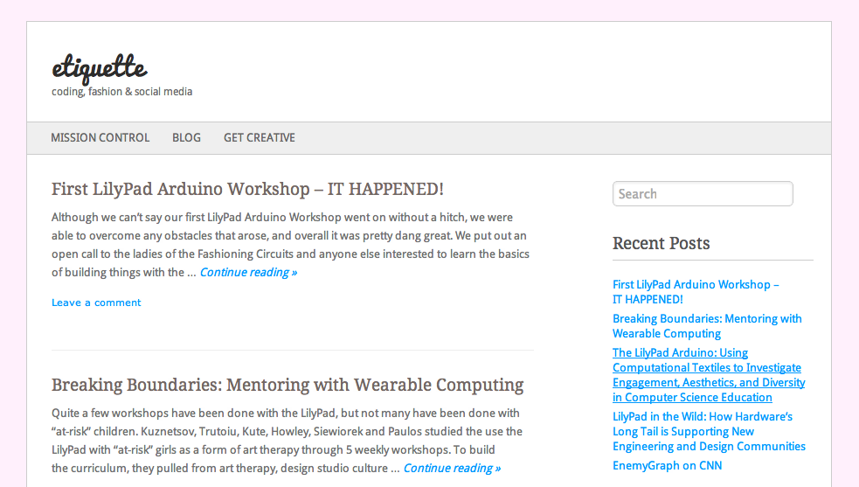
etiquettecreative.org
Notes:
Introduce etiquette, reinforce interactivity, asking questions, ideas are great, no bad ideas etc

Slide 4
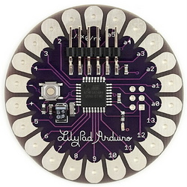
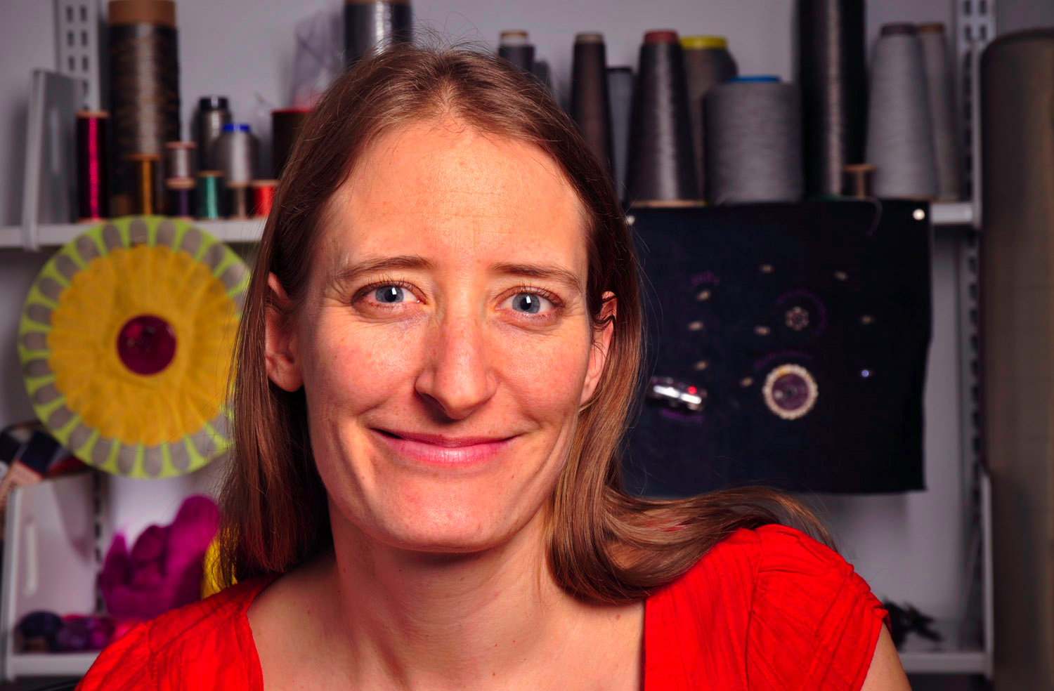
LilyPad History
Developed by Leah Buechley
Microcontroller board designed for wearables and e-textiles
The Brain
Notes:
Demonstrate how the product is used

Slide 5
LilyPad Arduino Examples
http://www.youtube.com/watch?v=L4a89n4ZJ5w
LED Biking Hoodie
Persistence of Vision Wristband
Embroidery
Notes:
Watch Example video, review examples
Tell them to think about other ideas as they watch the video, write them down if they have ideas

Slide 6
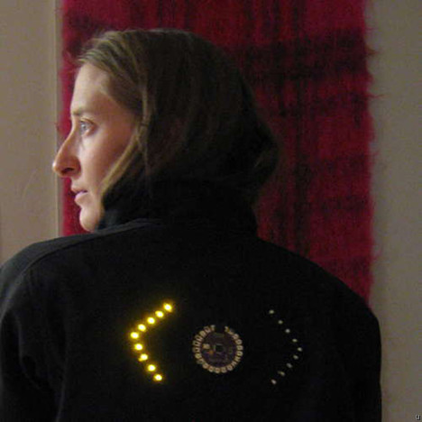
LilyPad Example: LED Biking Jacket
Notes:
Explain how the examples work, their purpose

Slide 7
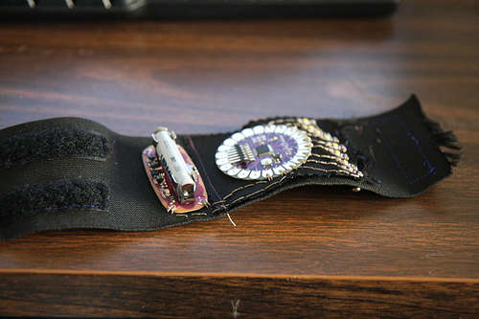
LilyPad Example: POV Bracelet

Slide 8
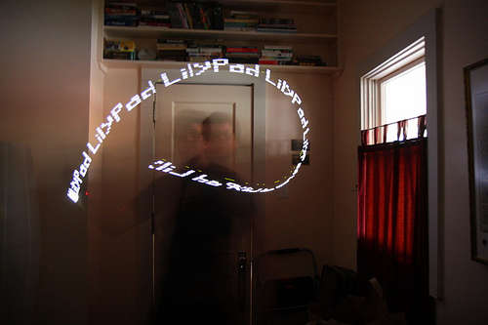
LilyPad Example: POV Bracelet

Slide 9
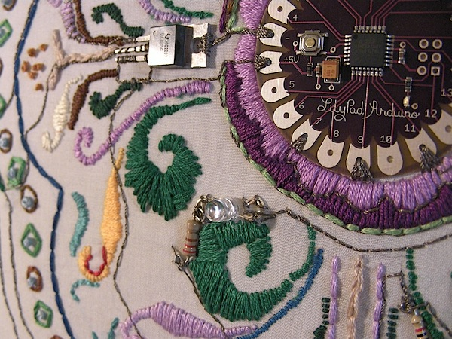
LilyPad Example: Embroidery

Slide 10
LilyPad Components
Electronics
Crafts, Sewing
Code

Slide 11
LilyPad Components
Electronics
Crafts, Sewing
Code
CREATIVITY
Notes:
Describe the three components
Allow 3-5 minutes for the girls to discuss ideas for projects, which projects did they like?

Slide 12
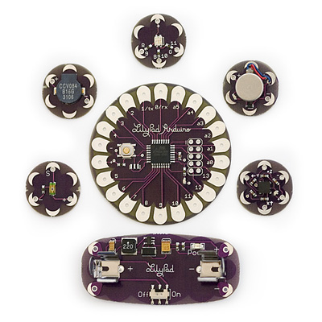
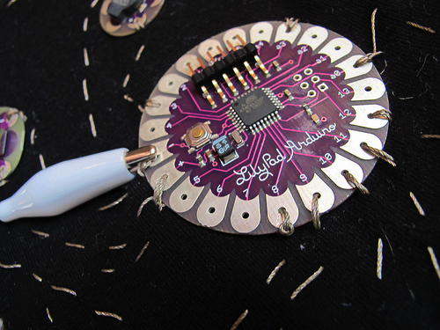
LilyPad Components: Electronics
Microcontroller (Brain)
Sensors (Ears, Eyes)
Actuators (Voice)
Notes:
Analogy to the human body, how the microcontrollers work
Ask questions about what they have done so far, have they worked with circuits to light something up in class
What do they know about circuits.

Slide 13
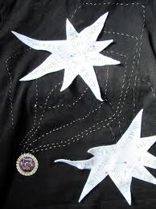
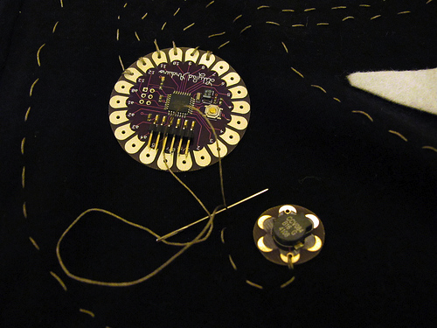
LilyPad Components: Sewing
How crafty can you be?
Notes:
Sewing hints, recall the twinkle, twinkle example

Slide 14
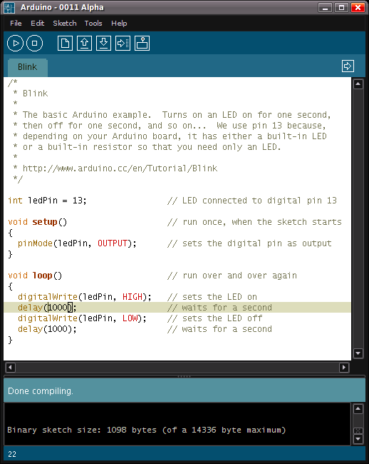
LilyPad Components: Coding
Arduino IDE
(Intergraded
Development
Environment)

Slide 15
LilyPad Components: Coding
Setup()
{ define the pins
}
Loop()
{ tell pieces what to do
}

Slide 16
LilyPad Components: Coding
int ledpin = 13; // Define the pins
Setup()
{ pinMode(ledpin, OUTPUT); // tell the microcontroller // if input or output
}
Loop()
{ digitalWrite(ledpin, HIGH); // Turn ON light
delay(1000);
digitalWrite(ledpin, LOW); // Turn OFF light
delay(1000);
}

Slide 17
LilyPad Components: Coding
int ledpin5 = 5;
Int ledpin6 = 6;
Setup()
{ pinMode(ledpin5, OUTPUT);
pinMode(ledpin6, OUTPUT);
}
Loop()
{ digitalWrite(ledpin5, HIGH);
delay(1000);
digitalWrite(ledpin5, LOW);
delay(1000);
digitalWrite(ledpin6,HIGH);
delay(1000);
digitalWrite(ledpin6,LOW);
delay(1000);
}
Notes:
Experimenting with code, DON’T GIVE UP, patience is key, explore, use the internet for solutions
Open source community, if youre having trouble people are there to help

Slide 18
Evaluate & Change
Any Ideas?
3 minutes to write down at least 2 ideas
Make up a sensor or actuator
Ideas under constraints
Potential Uses

Slide 19
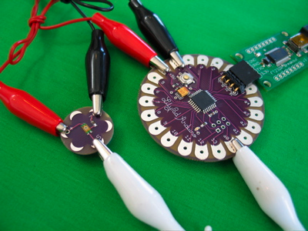
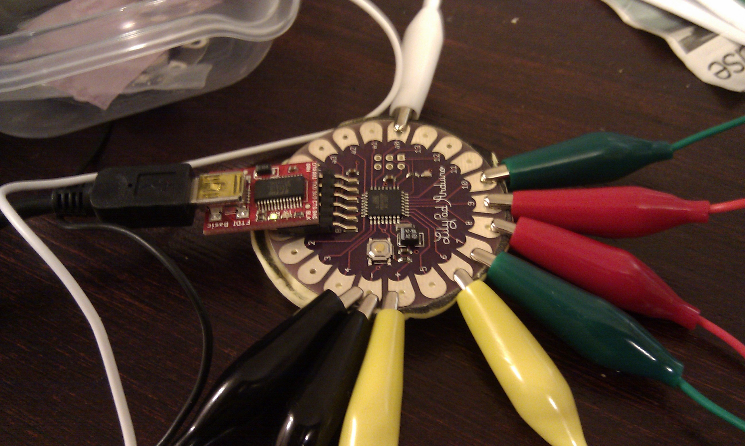
Time to Prototype!
Notes:
Work on the computers set up for use with LilyPad

Slide 20
New Ideas?
Evaluate the prototype
Likes?
Dislikes?
Changes for next time?
Documentation
Open Source
Share Ideas

Slide 21
Tinker at Home
Take home project with mini battery and LED
Thanks & Check out SparkFun for more cool gadgets

