Slide 1
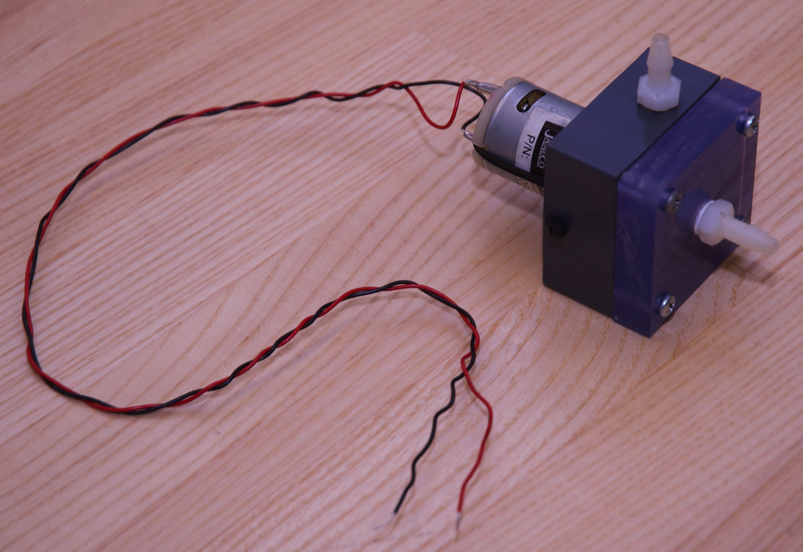
Pump Performance Testing

Slide 2
Goal: Measure the pump curve(s)
Head versus flow rate:
Efficiency versus flow rate:

Slide 3
Pump testing in a nutshell
Prep
  Make sure the pump works: dry and wet tests.
  Wire the circuit to measure voltage and current.
  Configure tubing for the pump test.
Data Collection
  Change height of exit tube. Record mass flow rate, voltage and current.

Slide 4
Make sure the pump works:
Dry and wet tests.

Slide 5
SAFETY
Keep water away from all electrical equipment except the pump, and do your best to keep the pump motor dry.
Don’t handle the power supply or multimeter(s) with wet hands or wet feet (or when in contact with water).
Prevent water from splashing onto or near the power supply.
Wipe up any water that leaks onto the floor.
Report any problems encountered to your instructor.

Slide 6
Dry Test: Make sure the impeller spins
Don’t run your pump too long without water. The purpose of the dry test is to verify that the motor works and that the impeller can rotate freely.

Slide 7
Debugging the dry test
If the impeller does not spin:
  Is the lid so tight that impeller rubs? If so, loosen the screws holding the lid in place.
  Is the motor misaligned? Try wiggling it.
  Are the electrical leads making good contact?
  Is the current limit on the power supply exceeded? Increase the current dial.

Slide 8
Wet Test: Make sure the pump can move water.

Slide 9
SAFETY
Keep water away from all electrical equipment except the pump, and do your best to keep the pump motor dry.
Don’t handle the power supply or multimeter(s) with wet hands or wet feet (or when in contact with water).
Prevent water from splashing onto or near the power supply.
Wipe up any water that leaks onto the floor.
Report any problems encountered to your instructor.

Slide 10
Priming the pump
Priming is the addition of water to the pump cavity so that the impeller can create enough suction to pull water from the supply reservoir.
Use gravity feed from the supply pail to cause water to flow into the pump cavity.

Slide 11
Priming the pump
Connect the outlet tube first.
Outlet tube

Slide 12
Priming the pump
1. Connect the outlet tube first.
2. Connect the inlet tube from the supply pail.
Inlet tube

Slide 13
Priming the pump
1. Connect the outlet tube first.
Connect the inlet tube from the supply pail.
3. Allow water to flow into the pump cavity.

Slide 14
Priming the pump
1. Connect the outlet tube first.
Connect the inlet tube from the supply pail.
Allow water to flow into the pump cavity.
Connect the power to the pump.

Slide 15
Debugging the wet test
If water is not flowing:
  Are there bubbles in the line between the pail and the pump? If so, tap the lines to move the bubbles.
  Is there water in the pump cavity? If not, make sure the inlet is below the surface of the water in the supply pail, and prime the pump.

Slide 16
Set up the electrical circuit for measuring pump voltage and pump current.
Do not start the test until you are also ready to measure V and I for the pump!

Slide 17
Electrical circuit for pump power measurement
Use your DMM to measure voltage
Use the bench-top DMM to measure current

Slide 18
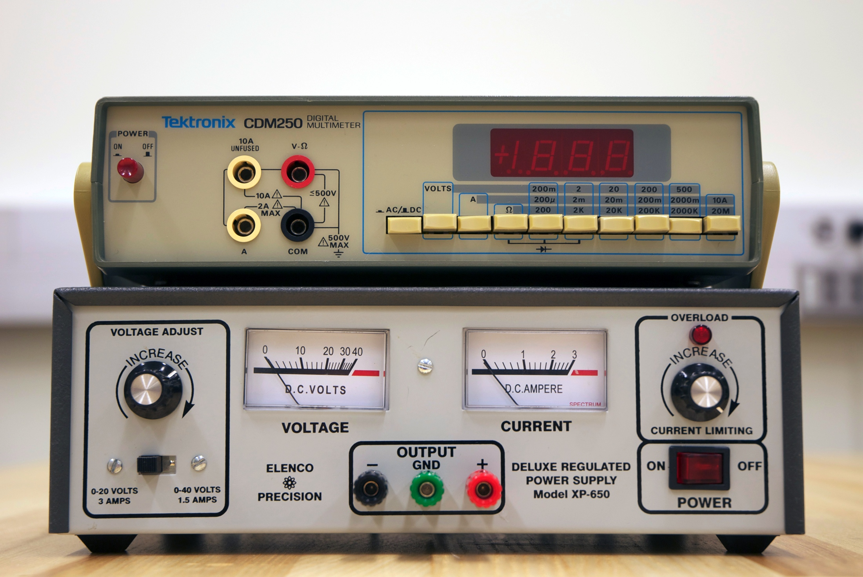
Can you make the connections?
Use the DMM on top of the power supply to measure current.

Slide 19
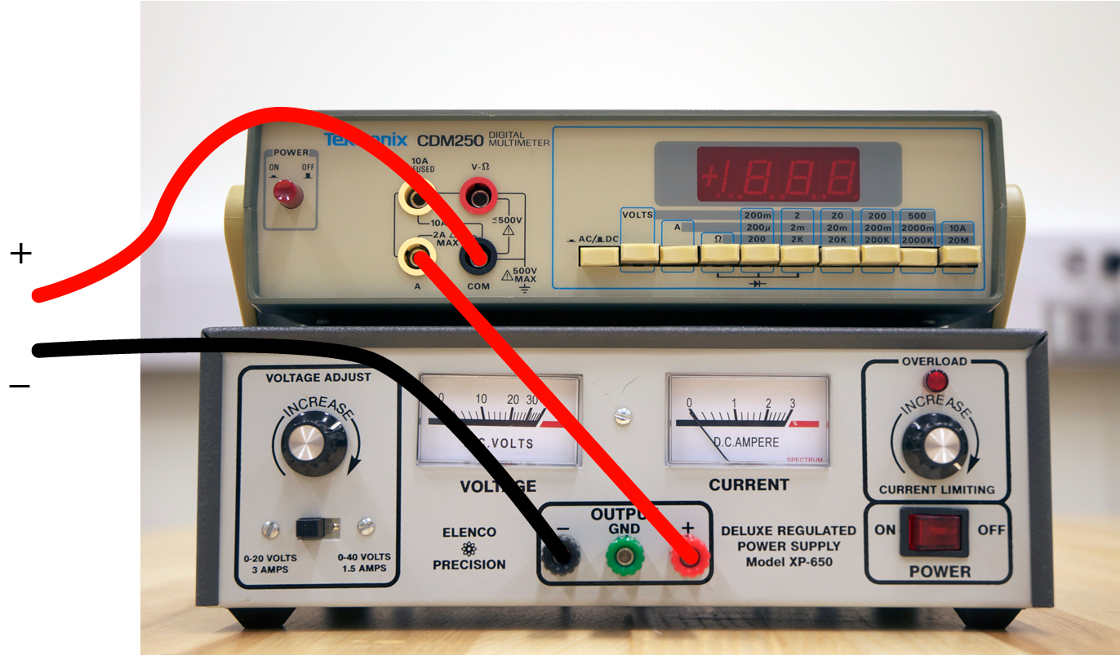
To measure current, the current must flow through the DMM: The DMM is in series to measure current

Slide 20
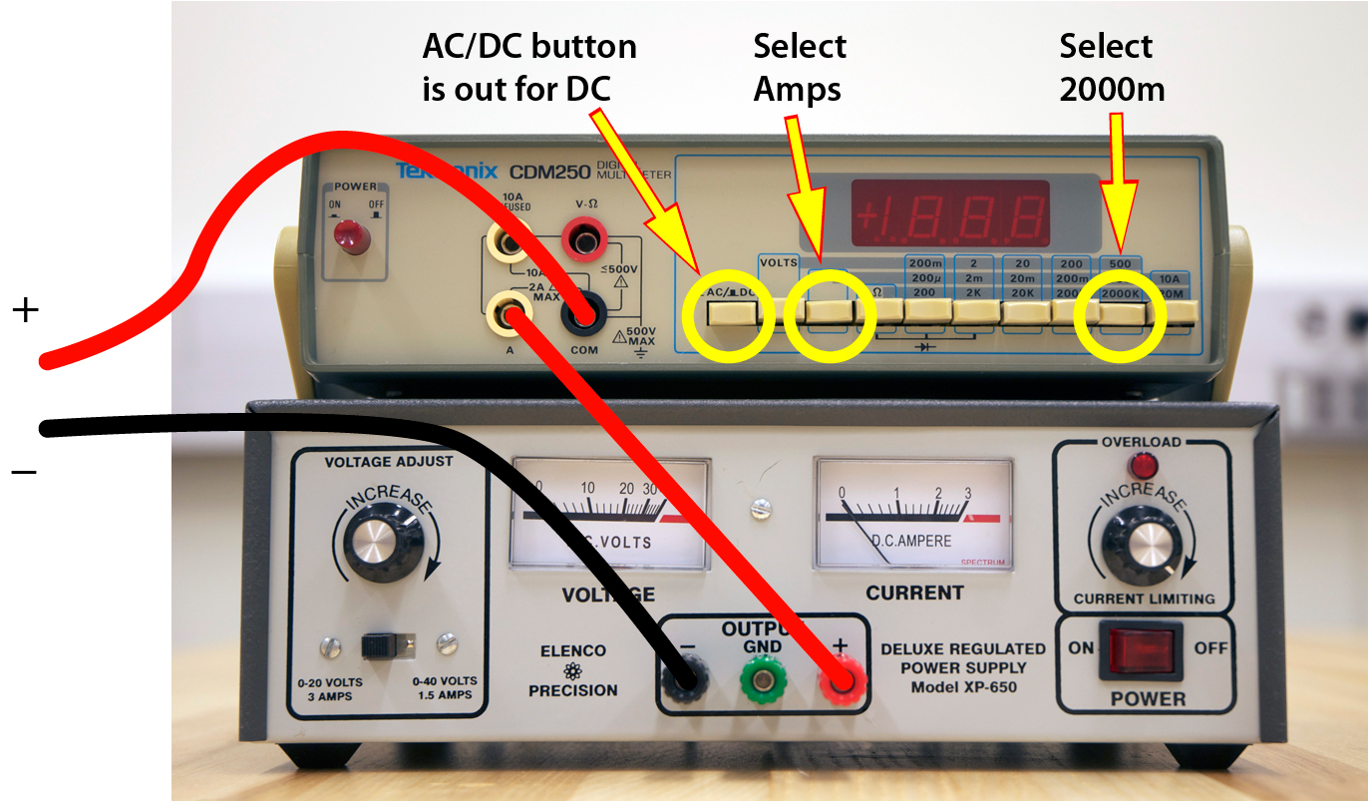
To measure current, the current must flow through the DMM, and the settings must be correct.

Slide 21
SAFETY
Keep water away from all electrical equipment except the pump, and do your best to keep the pump motor dry.
Don’t handle the power supply or multimeter(s) with wet hands or wet feet (or when in contact with water).
Prevent water from splashing onto or near the power supply.
Wipe up any water that leaks onto the floor.
Report any problems encountered to your instructor.

Slide 22
Configure the tubing for measuring the pump curve.

Slide 23
Configure the pump, tubing, meter stick, supply pail, and catch basin for the pump curve measurement
NOTE: h is the distance from outlet of the hose (top) to the free surface in the pail (bottom).

Slide 24
Preliminary Procedure
Fill the supply pail to about one-third of full.
IMPORTANT: Align the bottom of vertical scale to the water level in the bucket.
IMPORTANT: Set the tare weight of the small bucket.
Connect the pump to the supply pail and exit tube.
All steps are important!

Slide 25
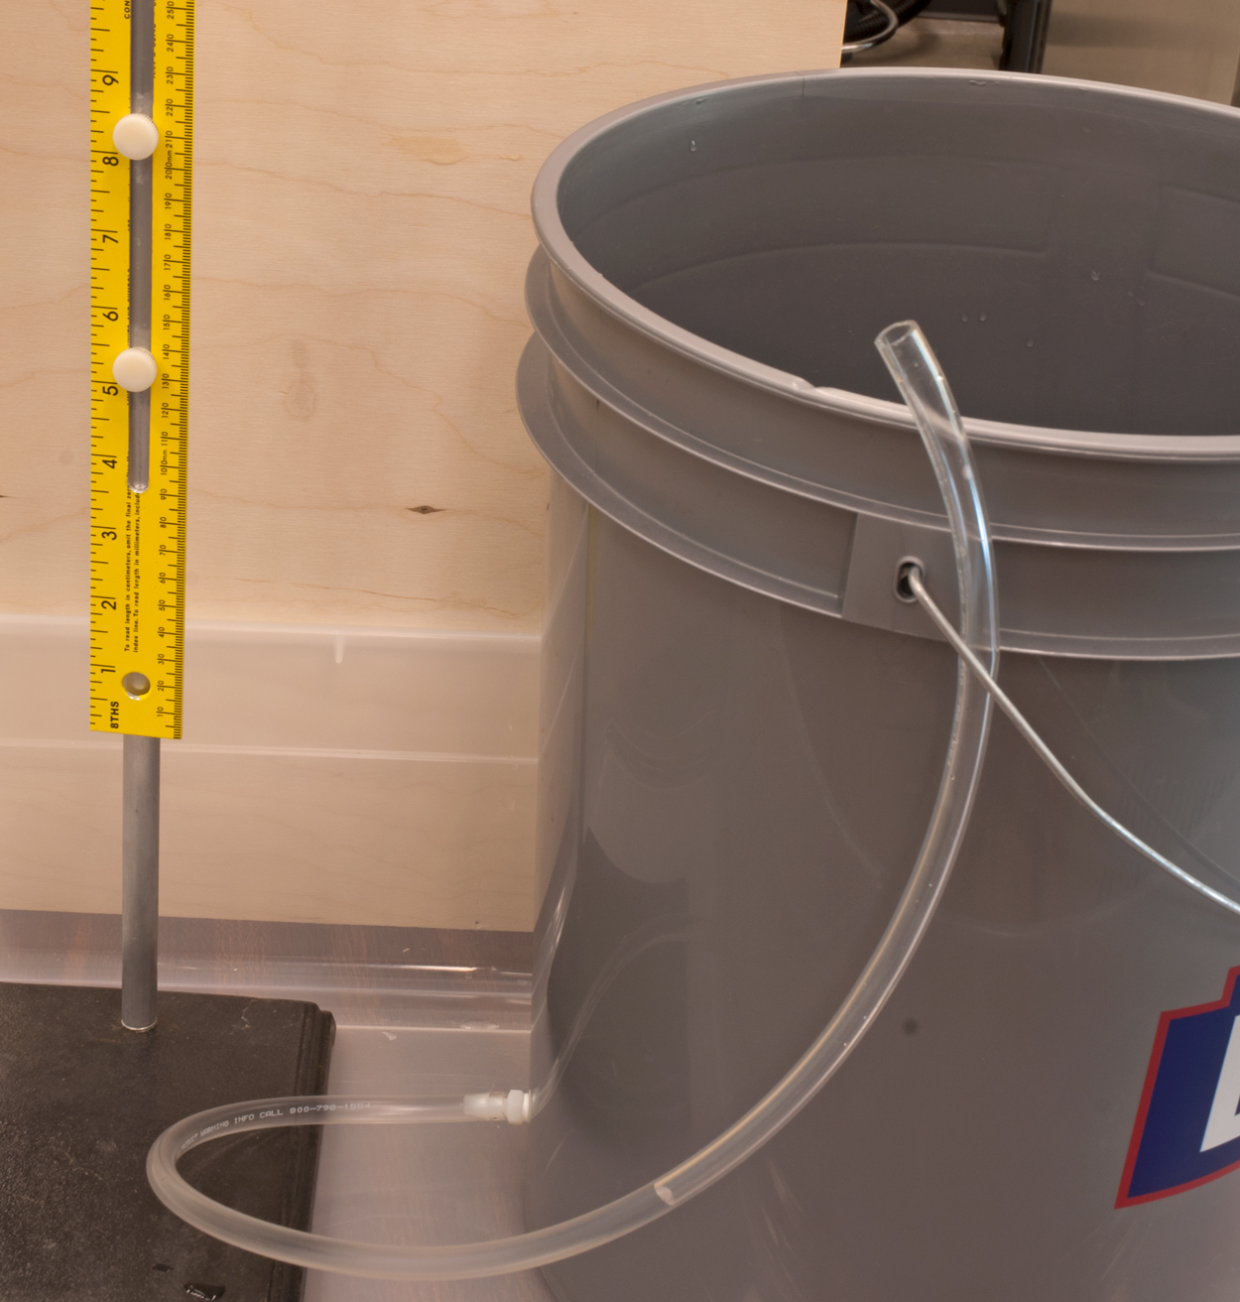
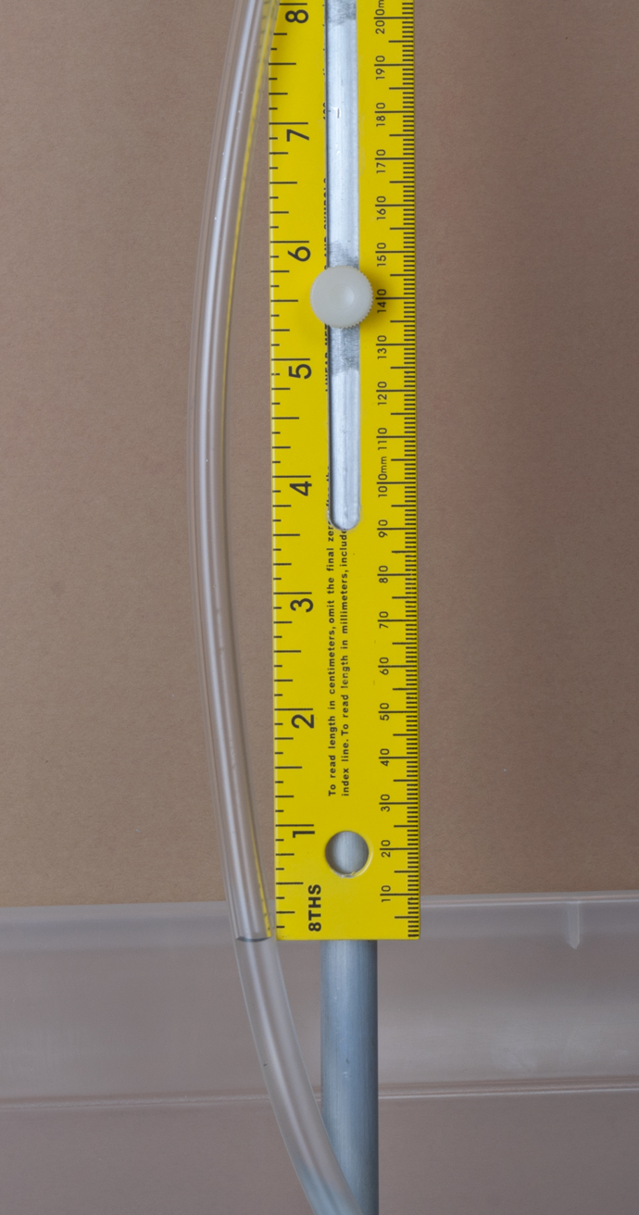
Align the vertical scale to the level of the water surface in the bucket
Adjustment screws
Look
here!

Slide 26
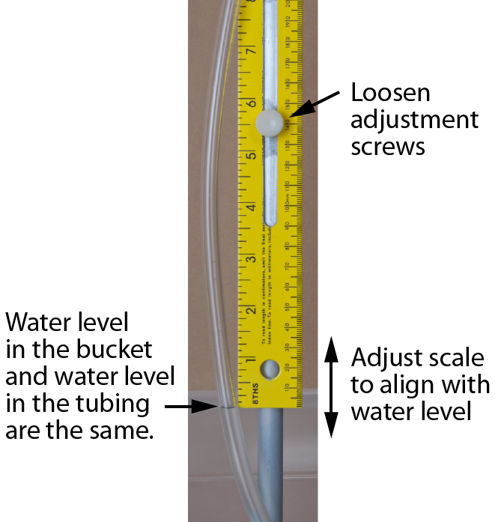
Align the vertical scale to the level of the water surface in the bucket

Slide 27
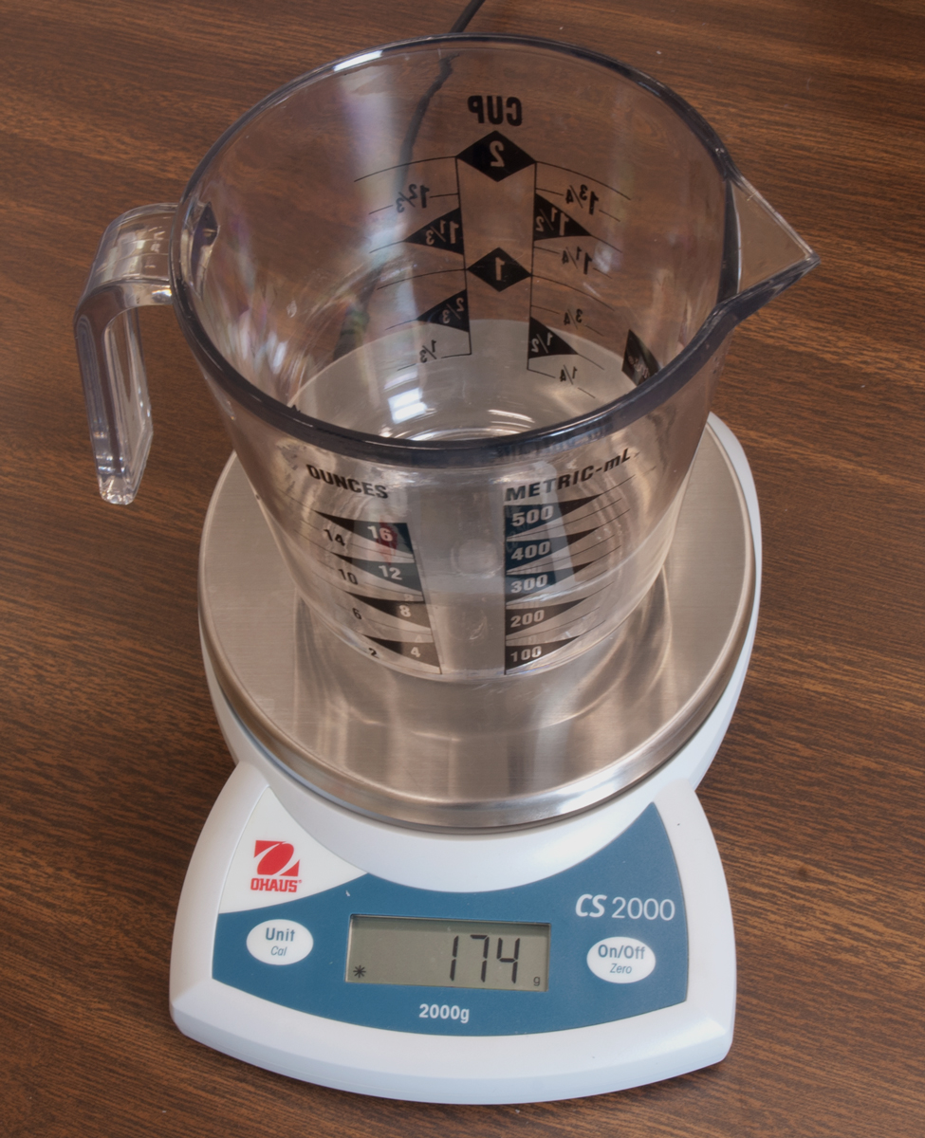
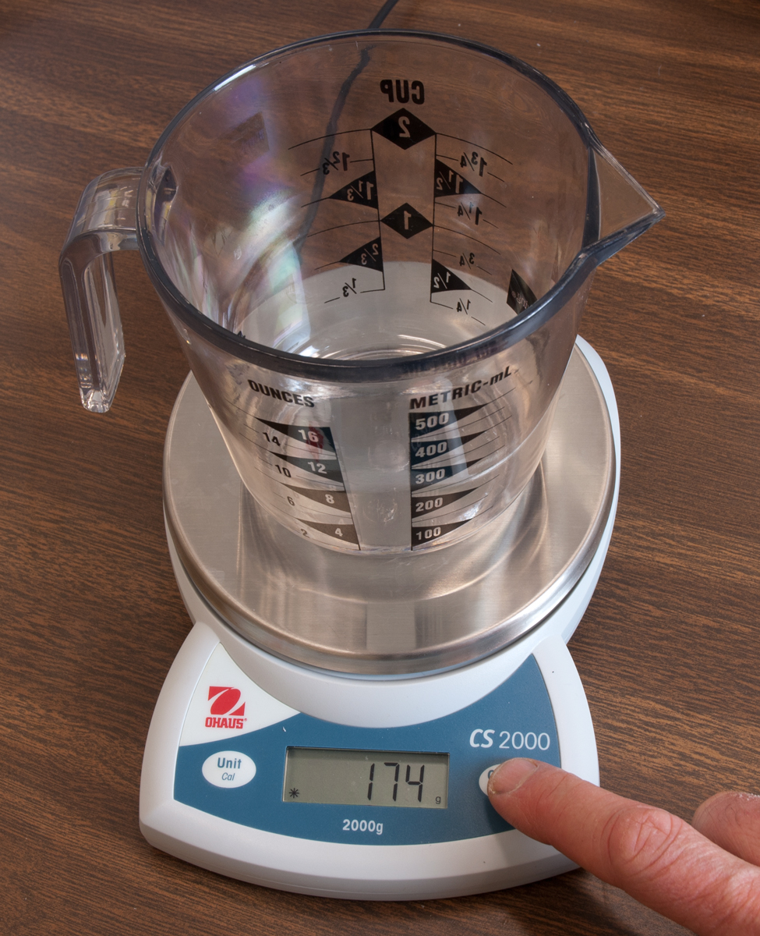
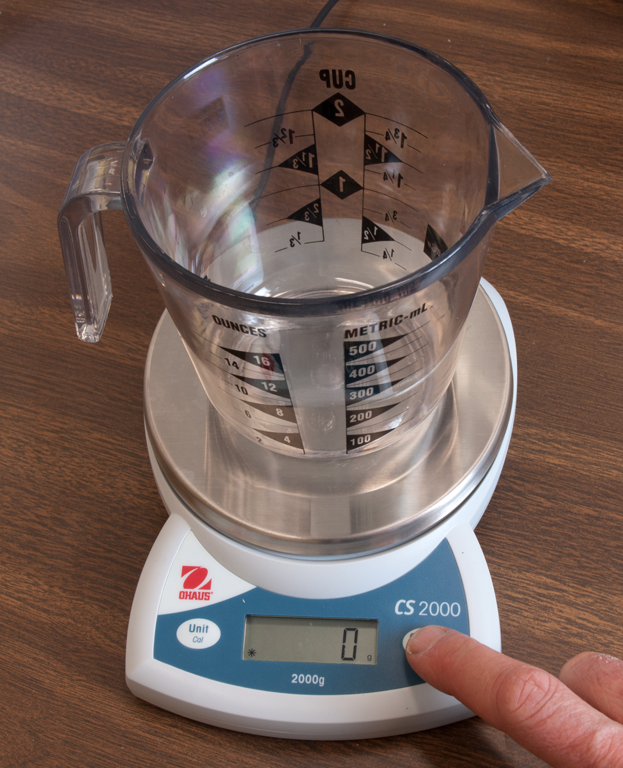
Use the tare function to cancel the dry weight of the pitcher used to collect water samples.
Empty pitcher on the scales
Before clicking “zero”
After clicking “zero”

Slide 28
Collecting Data: Basic Ideas
You choose h, then measure V, I, ∆m and ∆t
Allow ∆t of at least 15 seconds. Use longer times at low flow rates.
Use strategic selection of the order of h
  First measure at the extremes: Find the maximum h first.
  Fill in the middle of the range in random order
4. Use multimeters to measure V and I.
  Do not trust the meters on the power supply

Slide 29
Collecting Data: Basic Ideas (2)
5. Do not make physical changes (e.g. changing impellers) during a single data set. If you make changes, start over, but keep your data.
6. Do not throw away data. Make notes about suspicious data. Discard measurements only at the analysis stage when you are certain that the data is not valid.

Slide 30
Data Collection Procedure
Note: Keep the pump running during these measurements.
Empty the collection bucket.
Move the exit hose to a selected height
  Water jet should exit the hose horizontally
Start the timer as the collection bucket is moved to capture the water
Collect “enough” water
Record h, ∆m, ∆t, V and I
Repeat for at least 10 settings (10 h values).

Slide 31
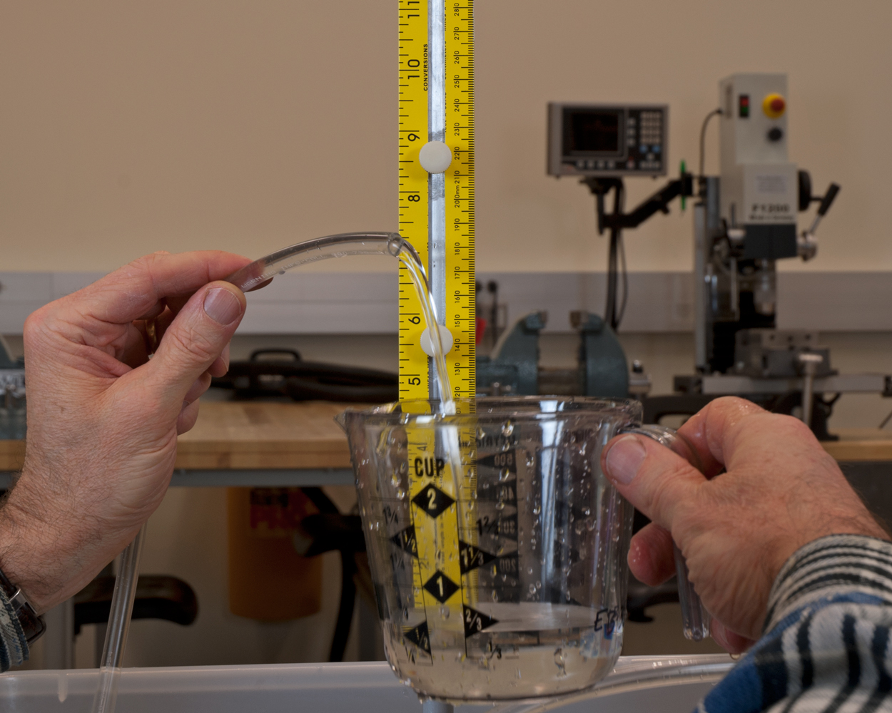
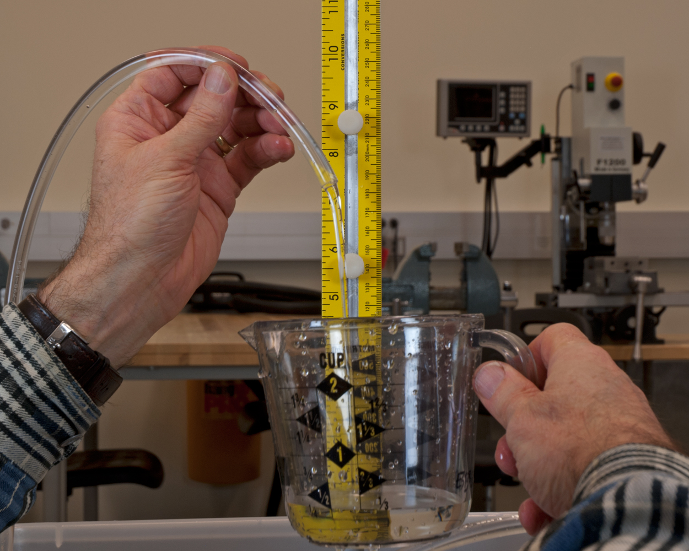
Exit tube should be horizontal
Like this:
Not like this:

Slide 32
Data sheet
Label the sheet with team members, date, type of impeller (if more than one is used)
Make columns of data for h, V, I, ∆m, ∆t.
h (inch) | V (volts) | I (amp) | ∆m (g) | ∆t (s)
This is just a sample data sheet. Make your own version on a full sheet of paper. Be prepared to take more data than you will eventually use.

Slide 33
Strategic data collection:

Slide 34
Strategic Data Collection
Take data where it matters.
There is no reason to use the same ∆t for each flow rate measurement.
The scientifically best procedure is to use longer ∆t for lower flow rates. Why?
There is no reason to use even increments of h.
The scientifically best procedure is to use a random order of h values. Why?

Slide 35
Naive data collection
There is no need to use equal spacing of h values.
There is no need to collect data in order of increasing or decreasing h. In fact, it’s a bad idea
The laws of Physics don’t care about equal ∆h!
Don’t do it!
Take h values in random and in strategic order.
Don’t do it!

Slide 36
Strategic data collection
First, establish the range of h for your pump.
Note that the maximum h may change during the test. Your pump performance will change as you run your pump.

Slide 37
Strategic data collection
The middle value of h determines the curvature of the data set

Slide 38
Strategic data collection
Perform the remainder of the measurements by selecting a random order of h values in the range between minimum and maximum h.

Slide 39
Strategic data collection
If the data reduction spreadsheet is created before taking measurements, you can see the pump curve emerge as data is collected. Otherwise, you will have to visualize the data with simple hand sketches.

Slide 40
Sample results

Slide 41
Summary
Study these slides before coming to lab
Create a data collection sheet (or spreadsheet) before starting the measurements.
Use dry and wet tests to debug your pump before setting up your measurements
Set up the V and I measurements
Take data strategically

