Slide 1
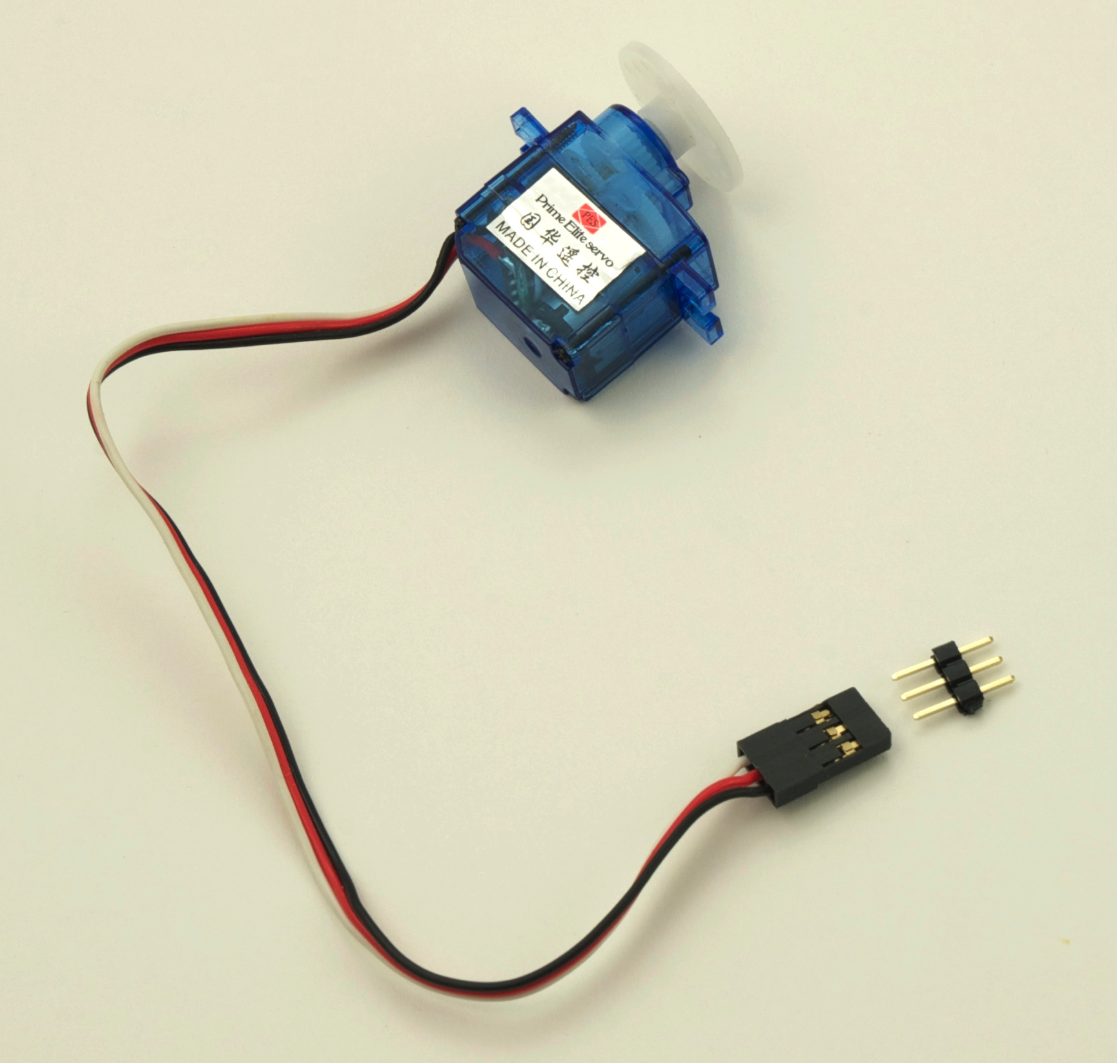
Using servos with an Arduino
EAS 199A Fall 2011

Slide 2
Learning Objectives
Be able to identify characteristics that distinguish a servo and a DC motor
Be able to describe the difference a conventional servo and a continuous rotation servo
Be able to use the Arduino Servo library to control servo position

Slide 3
References
Information on Arduino Servo library:
http://www.arduino.cc/en/Reference/Servo
http://www.arduino.cc/playground/Learning/SingleServoExample
Additional descriptions of servos
http://makeprojects.com/Wiki/Servos
http://www.seattlerobotics.org/guide/servos.html

Slide 4
What is a servo?
A servo-motor is an actuator with a built-in feedback mechanism that responds to a control signal by moving to and holding a position, or by moving at a continuous speed.

Slide 5
DC Motors and Servos
DC Motor
Motion is continuous
Speed controlled by applied voltage
Servo
Capable of holding a position
Speed controlled by delay between position updates
Hybrid of motor, gears and controller.

Slide 6
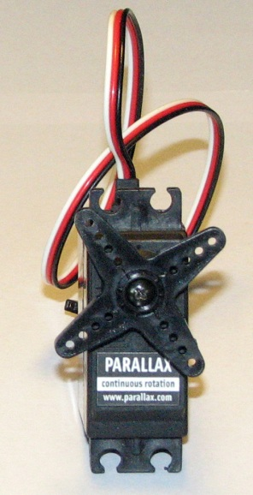
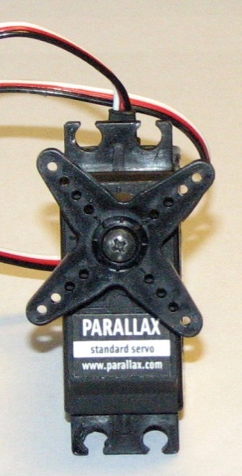
Conventional and Continuous Rotation
Two types of servos
continuous rotation
standard
can rotate all the way around in either direction
can only rotate 180 degrees
pulse tells servo
which way to spin & how fast to spin
pulse tells servo
which position to hold

Slide 7
Control signal is a pulse train
Pulse frequency is fixed
Typical: 20 ms
Pulse width determines position
Typical: 1ms to 2 ms

Slide 8
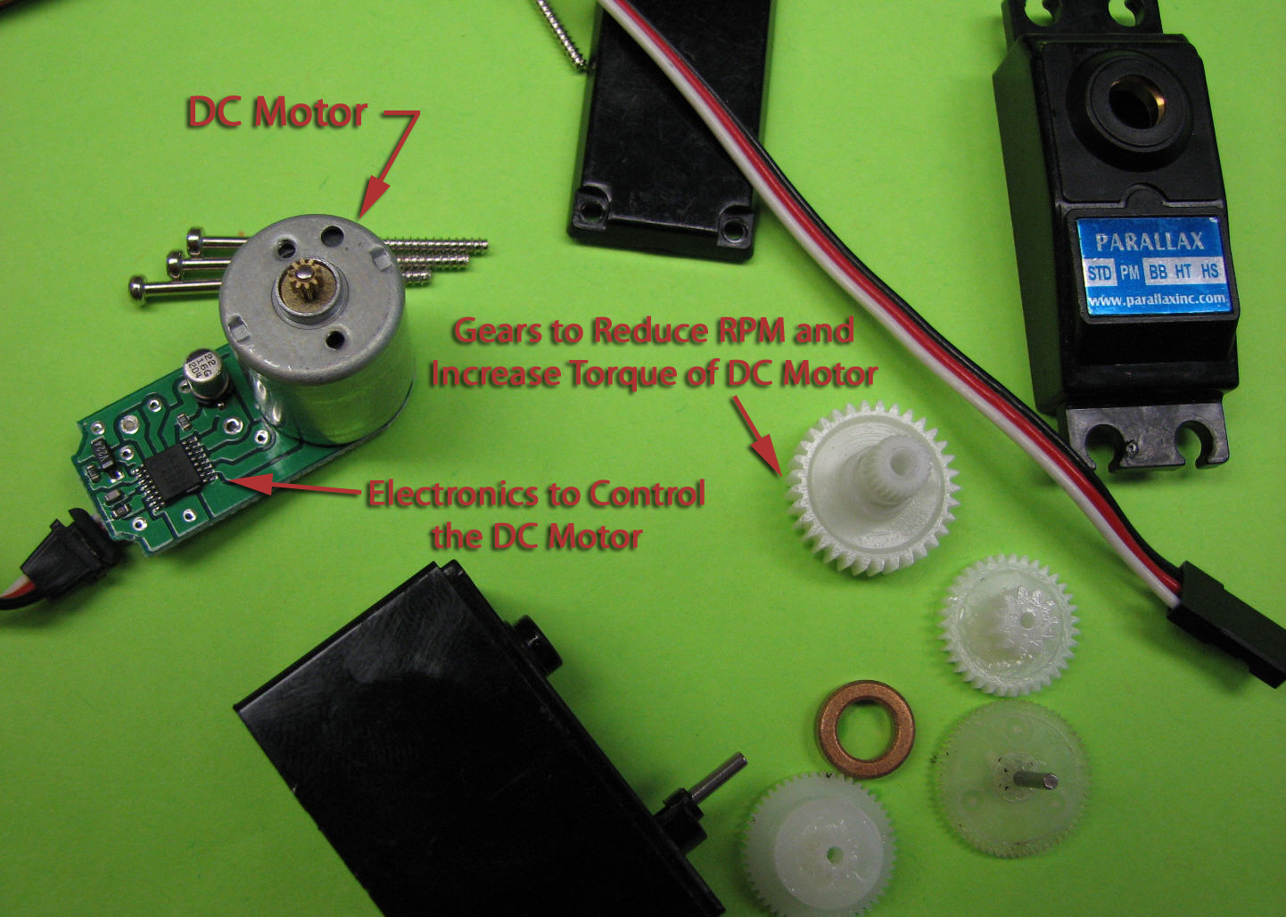
Servo components
Small DC motor
Gearbox with small plastic gears to reduce the RPM and increase output torque
Special electronics to interpret a pulse signal and deliver power to the motor

Slide 9
Servo from the Sparkfun kit
The micro servo from the Sparkfun Inventor’s kit is a conventional servo, i.e. the control signal results in moving the shaft to an angular position.

Slide 10
Arduino Servo library handles the details
Must connect servos on pin 9 or pin 10
From the Aduino web site:
“…use of the library disables analogWrite() (PWM) functionality on pins 9 and 10, whether or not there is a Servo on those pins”
http://www.arduino.cc/en/Reference/Servo

Slide 11
Arduino Servo library handles the details
Three components of the Servo Library
  Create the servo object
    Servo my_servo_object;
  Attach the object
    my_servo_object.attach(servo_pin);
  Send control signal
    my_servo_object.write(pos);
Name of the object is like a variable name.
attach and write are pre-defined methods that act on the servo object.

Slide 12
Modified version of the sweep function
// File: sweep_variable_wait
//
// Modified version of Sweep by BARRAGAN <http://barraganstudio.com>
// Use variable dtwait to make the speed of sweep aparent
#include <Servo.h> // Make code in Servo.h available to this sketch
Servo myservo; // Create servo object called "myservo"
int servo_pin=9; // The servo must be attached to pin 9 or pin 10
void setup()
{
myservo.attach(servo_pin); // attaches the servo pin to myservo object
}
void loop()
{
int pos = 0; // variable to store the servo position
int dtwait=15; // duration of wait at the end of each step
for(pos = 0; pos < 180; pos += 1) {
myservo.write(pos); // Move to position in variable 'pos'
delay(dtwait); // wait dtwait for the servo to reach the position
}
for(pos = 180; pos>=1; pos -= 1) {
myservo.write(pos); // Move to position in variable 'pos'
delay(dtwait); // wait dtwait for the servo to reach the position
}
}

Slide 13
Experiment
What happens when you adjust dtwait?
Can adjust the sweep angle?
  Make new variable to define end angle of the loop
Open the Knob demo from the Arduino IDE
  Connect a potentiometer to an analog input
  Use the potentiometer to control the servo position

